Slide 1

http://www.vidyanidhi.com/
ketkiacharya.net@gmail.com
Ketki Acharya
From: SM VITA ATC of CDAC
9769201036
ketkiacharya.net@gmail.com

Slide 2
MySQL
Install :
https://dev.mysql.com/downloads/file/?id=532678
How to load sample database
Use the source command to load data into the MySQL Server:
source D:\SQLTRaining\SQLTRaining\ A_VLT\MySQL_Training\database\mysqlsampledatabase.sql
It will create database classicmodels

Slide 3
How to create database in MySql
How to create database
CREATE DATABASE testDB;
Drop databse testDB;
Above code will create a database with name testDB
In Simple term it will create a folder.
testDB
How to create table
PersonID | Name | Address | City
CREATE TABLE Persons ( PersonID int, Name varchar(255), Address varchar(255), City varchar(255) );
To see this code again you can use
show create table Persons;
Above code create table in data base
In simple term table is nothing but a file but its is structured one
Which enables you to insert, update delete and view data using SQL
Ie. Structured Query Language

Slide 4
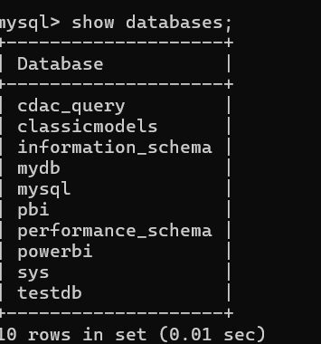
How to change database in MySql
How to list all database created in Mysql Server
mysql> show databases;
The above command will display all databases created in Mysql Server
USE DATABASE testDB; OR
Use textDB; this command depend on which version you are using
testDB
Above code will a take you to testDB database
In Simple term you are changing folder

Slide 5
Use the SHOW DATABASES command to list all databases in the current server:
mysql> show databases;
Change databse
USE classicmodels;
SELECT * FROM customers;
Basically, those statements switch the current database to classic models and query data from the customers table. If you see the customer data returned, you have successfully imported the sample database into the MySQL database server.
The MySQL sample database schema consists of the following tables:
Customers: stores customer’s data.
Products: stores a list of scale model cars.
ProductLines: stores a list of product line categories.
Orders: stores sales orders placed by customers.
OrderDetails: stores sales order line items for each sales order.
Payments: stores payments made by customers based on their accounts.
Employees: stores all employee information as well as the organization structure such as who reports to whom.
Offices: stores sales office data.

Slide 6
Step 1: Download the classicmodels database from the MySQL sample database section.
Step 2: Unzip the downloaded file into a temporary folder. You can use any folder you want. To make it simple, we will unzip the file to the C:\temp folder.
If you use another operating system such as macOS, Linux, or Unix, please feel free to unzip it to any directory you like.
Step 3
Connect to the MySQL server using the mysql client program. The mysql program is located in the bin directory of the MySQL installation folder.
> mysql -u root -p
Enter password: ********
You will need to enter the password for the root user account to log in.
Step 4
Use the source command to load data into the MySQL Server:
mysql> source c:\temp\mysqlsampledatabase.sql
Step 5: Use the SHOW DATABASES command to list all databases in the
current server:
mysql> show databases;
The output will look like the following that includes the newly created classicmodels database:
+--------------------+
| Database |
+--------------------+
| classicmodels |
| information_schema |
| mysql |
| performance_schema |
| sys |
+--------------------+

Slide 7
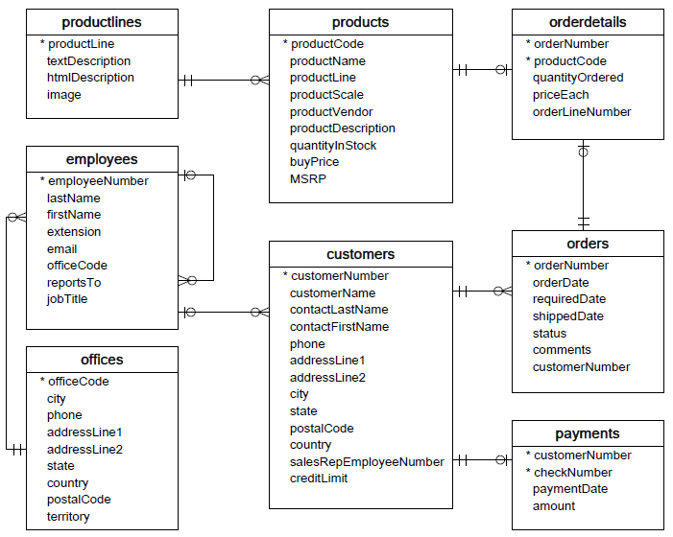
customers: stores customer’s data.
products: stores a list of scale model cars.
productlines: stores a list of product lines.
orders: stores sales orders placed by customers.
orderdetails: stores sales order line items for every sales order.
payments: stores payments made by customers based on their accounts.
employees: stores employee information and the organization structure such as who reports to whom.
offices: stores sales office data.

Slide 8
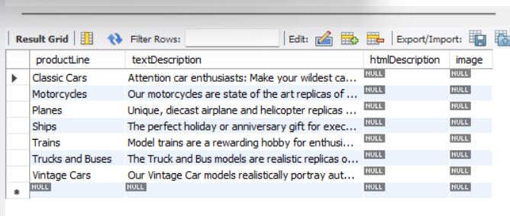
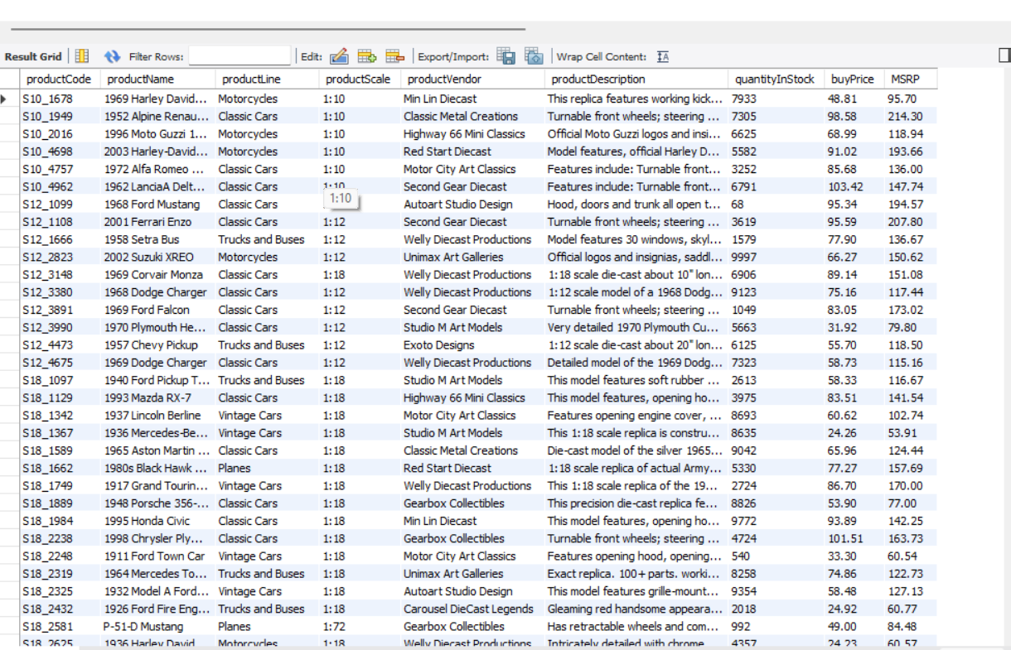

Slide 9
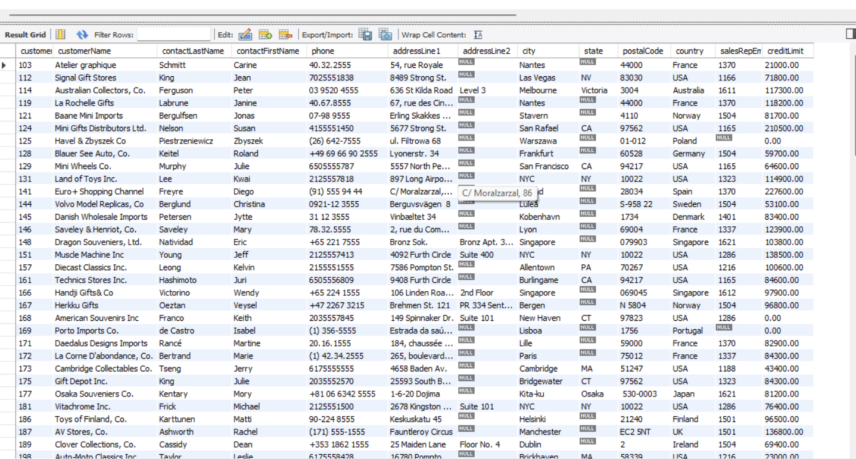

Slide 10
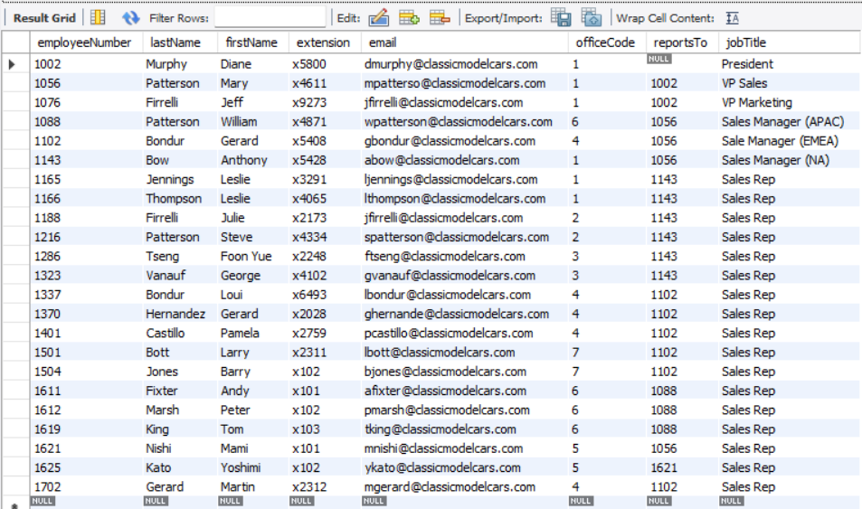
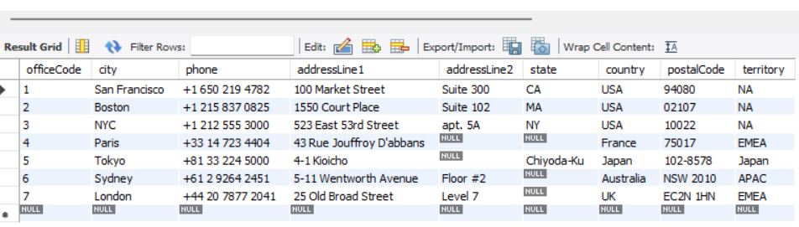

Slide 11
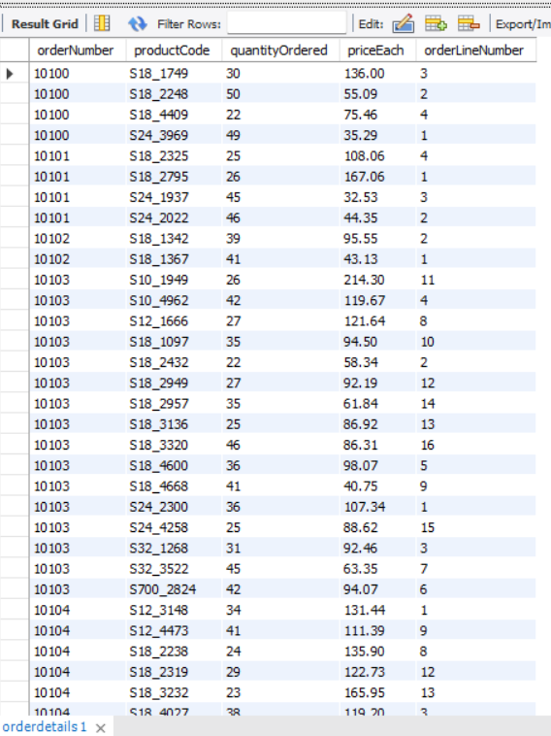
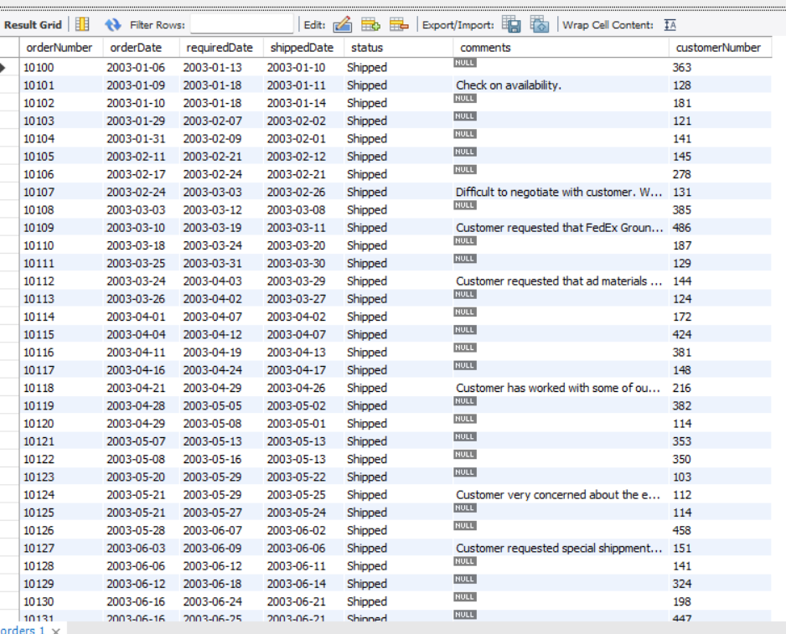

Slide 12

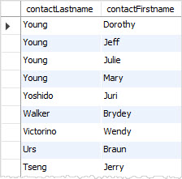
Introduction to MySQL SELECT statement
Introduction to MySQL ORDER BY clause
By default, the ORDER BY clause uses ASC if you don’t explicitly specify any option.
It is possible to sort the result by a column in ascending order, and then by another column in descending order:
1.
SELECT lastName
FROM employees;
2.
SELECT *
FROM employees;
3.
SELECT
lastname,
firstname,
jobtitle
FROM
employees;
In this server will load 1st read From command and load employee table in memory. Then select column
Note that the ORDER BY clause is always evaluated after the FROM and SELECT clause.
Using * in select statement is not a good practice
SELECT contactLastname, contactFirstname FROM customers ORDER BY contactLastname DESC, contactFirstname ASC;
Q.
Display all lastname in descending order from customers table and contactFirstname in Ascending order.
In this example, the ORDER BY clause sorts the result set by the last name in descending order first and then sorts the sorted result set by the first name in ascending order to produce the final result set.

Slide 13
🚫 Why Is Problematic
1. Performance Overhead
• Fetches all columns, even those you don’t need.
• Increases I/O load and network traffic, especially with large tables.
• Slows down query execution and client-side processing.
2. Security Risks
• May expose sensitive data unintentionally (e.g., passwords, financial info).
• Harder to audit and control what data is being accessed.
3. Ambiguity in Joins
• If joining tables with overlapping column names (like ), can cause confusion or errors.

Slide 14
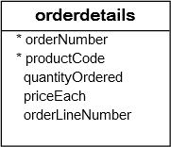
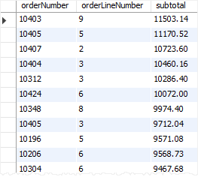
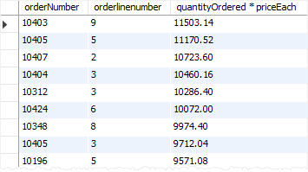
Using MySQL ORDER BY to sort a result set by an expression example
To make the query more readable, you can assign the expression in the SELECT clause a column alias and use that column alias in the ORDER BY clause
See the following orderdetails table from the sample database.
SELECT orderNumber, orderLineNumber, quantityOrdered * priceEach AS subtotal FROM orderdetails
ORDER BY subtotal DESC;
Q
Display qty*price orderBy desc.
SELECT orderNumber, orderlinenumber, quantityOrdered * priceEach
FROM orderdetails
ORDER BY quantityOrdered * priceEach DESC;
referring to orderLineNumber in our orderdetails table, it typically represents the sequence of items within an order, ensuring each product in an order has a unique position.

Slide 15
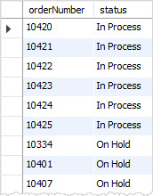
Using MySQL ORDER BY to sort data using a custom list
The ORDER BY clause allows you to sort data using a custom list by using the FIELD() function.
Suppose that you want to sort the sales orders based on their statuses in the following order:
In Process
On Hold
Canceled
Resolved
Disputed
Shipped
To do this, you can use the FIELD() function to map each order status to a number and sort the result by the result of the FIELD() function:
SELECT orderNumber, status FROM orders ORDER BY FIELD(status, 'In Process', 'On Hold', 'Cancelled', 'Resolved', 'Disputed', 'Shipped');
Display record order by this
1 | 2 | 3 | 4 | 5 | 6
'In Process | 'On Hold' | 'Cancelled' | 'Resolved' | Disputed | Shipped
FIELD Function returns the index of the status in the list 'In Process', 'On Hold', 'Cancelled', 'Resolved', 'Disputed', 'Shipped'.
For example, if the status is In Process, the function will return 1. If the status is On Hold, the function will return 2, and so on.

Slide 16
Internal Mechanics of FIELD() and ORDER BY
Here’s what happens under the hood:
Row Evaluation:
For each row, MySQL evaluates FIELD(status, ...).
It compares the status value of the row to the list: 'In Process', 'On Hold', 'Cancelled', 'Resolved', 'Disputed', 'Shipped'.
Position Mapping:
FIELD() returns the 1-based index of the match:
'In Process' → 1
'On Hold' → 2
'Cancelled' → 3
… and so on.
If status is not in the list, it returns 0.
Sorting:
MySQL uses the numeric result of FIELD() to sort rows.
So rows with 'In Process' come first, 'On Hold' next, and 'Shipped' last.
Any status not in the list (e.g., 'Pending') gets 0 and appears before the listed ones unless you add logic to
push them down.
🧪 Example Breakdown
After sorting: Pending, On Hold, Cancelled, Shipped — unless you handle 0 explicitly.
⚙️ Performance Note
FIELD() is evaluated per row, so it’s not index-optimized.

Slide 17
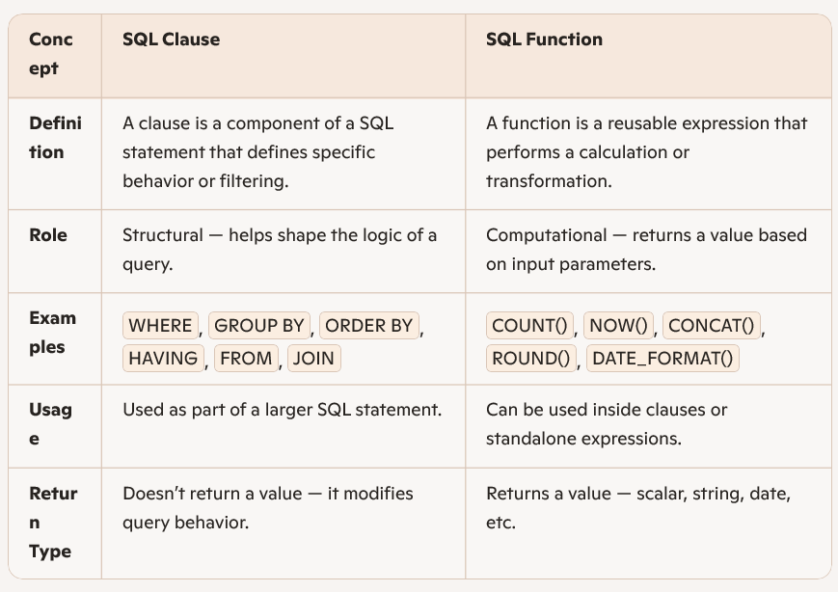
SQL Clause vs SQL Function
- Say clauses are like the grammar of SQL — they structure the sentence.
- Functions are like verbs — they perform actions or return results.

Slide 18
While we can't see the exact source code of MySQL's clause execution (since it's part of a massive C++ codebase), we can absolutely explore how clauses are processed conceptually and peek into simplified logic that mimics their behavior.
🧠 How SQL Clauses Work Internally (Conceptual Flow)
When you run a query like:
SELECT name FROM employees WHERE salary > 50000 ORDER BY name;
MySQL's query engine processes it in roughly this order:
FROM Clause
Identifies the table (employees) and loads metadata.
Applies any joins or subqueries.
WHERE Clause
Filters rows based on conditions (salary > 50000).
Uses indexes if available to speed up filtering.
SELECT Clause
Projects the required columns (name).
Applies expressions or functions if needed.
ORDER BY Clause
Sorts the filtered result set (name ASC by default).
May use temporary filesort or indexes.
LIMIT Clause (if present)
Truncates the result to the specified number of rows.

Slide 19
🔧 Simulated Internal Logic (Pseudocode)
Here’s a simplified version of how MySQL might internally process a query:
for (Row row : employees_table) {
if (row.salary > 50000) {
// WHERE clause
result_set.add(row.name);
// SELECT clause
}
}
result_set.sort_by_name();
// ORDER BY clause
This is obviously abstracted, but it mirrors the logical flow.
In reality, MySQL uses a query optimizer to choose the best execution plan, possibly rewriting parts of the query or using indexes and buffers.
🔍 Want to See Real MySQL Source?: If you're feeling adventurous, you can explore MySQL’s open-source codebase:
GitHub Mirror: https://github.com/mysql/mysql-server/blob/trunk/sql/sql_select.cc
Look into files like sql_select.cc and sql_executor.cc for clause handling logic.
These files contain the C++ implementations of query parsing, optimization, and execution — but fair warning, it's dense and complex.

Slide 20
